Slide 1
How to Read Valmont Drawings

Slide 2

Objectives
  The purpose of this webinar is to help you become familiar with Valmont’s customer drawings.
  In this webinar, we will discuss:
    Customer Drawing Requests
    Customer Drawing Approval
    Types of Customer Drawings and Their Purpose
    Standard Drawing Layout
    Typical Drawing Symbols

Slide 3
Customer Drawing Requests
01

Slide 4
Customer Drawing Requests
  Valmont receives the request for a customer drawing typically through a Valmont agent.
  The request is entered into our system by the assigned Project Administrator and placed in queue.
  Requests requiring design review are analyzed by our in-house Engineering staff.
  Drafting creates the customer drawing based on the project and/or customer requirements.
    Purchase order (PO), plans, specifications, calculations prepared by Engineering, documented information from email communications between agent and Valmont, etc.
  The completed customer drawing package is typically sent back to the Valmont agent for distribution to the project owner or approving authority.
    Customer drawing
    Formal calculations from Engineering (if required per project and/or customer requirements)
    Professional Engineering (PE) stamp (if required per project and/or customer requirements)

Slide 5
Customer Drawing Requests
  Customer drawings are manually created using AutoCAD. Marketing Illustrations are manually created using a variety of programs such as AutoCAD, Inventor, Showcase, Photoshop, and Illustrator.
  Drawings are not to scale but shall be proportional.
  The type of customer drawing requested by the Valmont agent shall be based on the customer’s needs and the phase of the project. Some projects require a simple drawing while others require a more detailed drawing.
  The different types of customer drawings include:
    Marketing Illustration
    Sales Proposal
    Submittal Drawing
    Record Drawing
    DB Drawing
  Sales Proposal, Submittal, Record and DB drawings are visually very similar but may have differences in the degree of detail being provided.

Slide 6
Customer Drawing Approval
02

Slide 7
Customer Drawing Approval
  Some types of customer drawings require approval from the project owner or approving authority before the project can be released for manufacturing.
  The project owner or approving authority will review the customer drawing package and provide comments and direction back thru the appropriate channels to Valmont.
  Customer drawing approval definitions:
    Approved Without Exception – The customer drawing is approved as submitted without exception. No revisions are required. Material can be manufactured as submitted with release of the project.
    Approved as Noted – The customer drawing is approved as noted. Revisions are required however a revised customer drawing (otherwise known as a resubmittal) is not needed. Material can be manufactured as noted with release of the project.
    Reject and Resubmit - The customer drawing is rejected and a resubmittal is required. The customer drawing will be revised and a resubmittal package will be provided for review by the project owner or approving authority. Material can not be manufactured until the approving authority approves the drawing.

Slide 8
Types of Customer Drawings and Their Purpose
03

Slide 9
Types of Customer Drawings and Their Purpose
    Marketing Illustration
    Application: Pre-quote or quote visual reference
    Typical Lead Time: 5 working days
    Option of a basic 2D or Valmont’s new 3D concept drawing created for visual representation of the proposed product’s appearance. Structure size will be noted for perspective but may not represent the actual project required sizes. This type of drawing lacks the details necessary for Valmont to release for manufacturing. All components shall be drawn in proportion.
    Full paper size is either 8.50” x 11” or 11” x 17”.

Slide 10
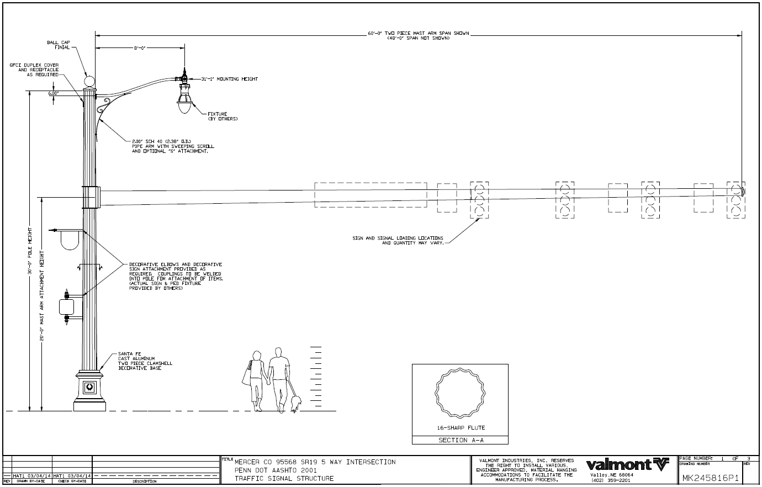
2D Marketing Illustration

Slide 11
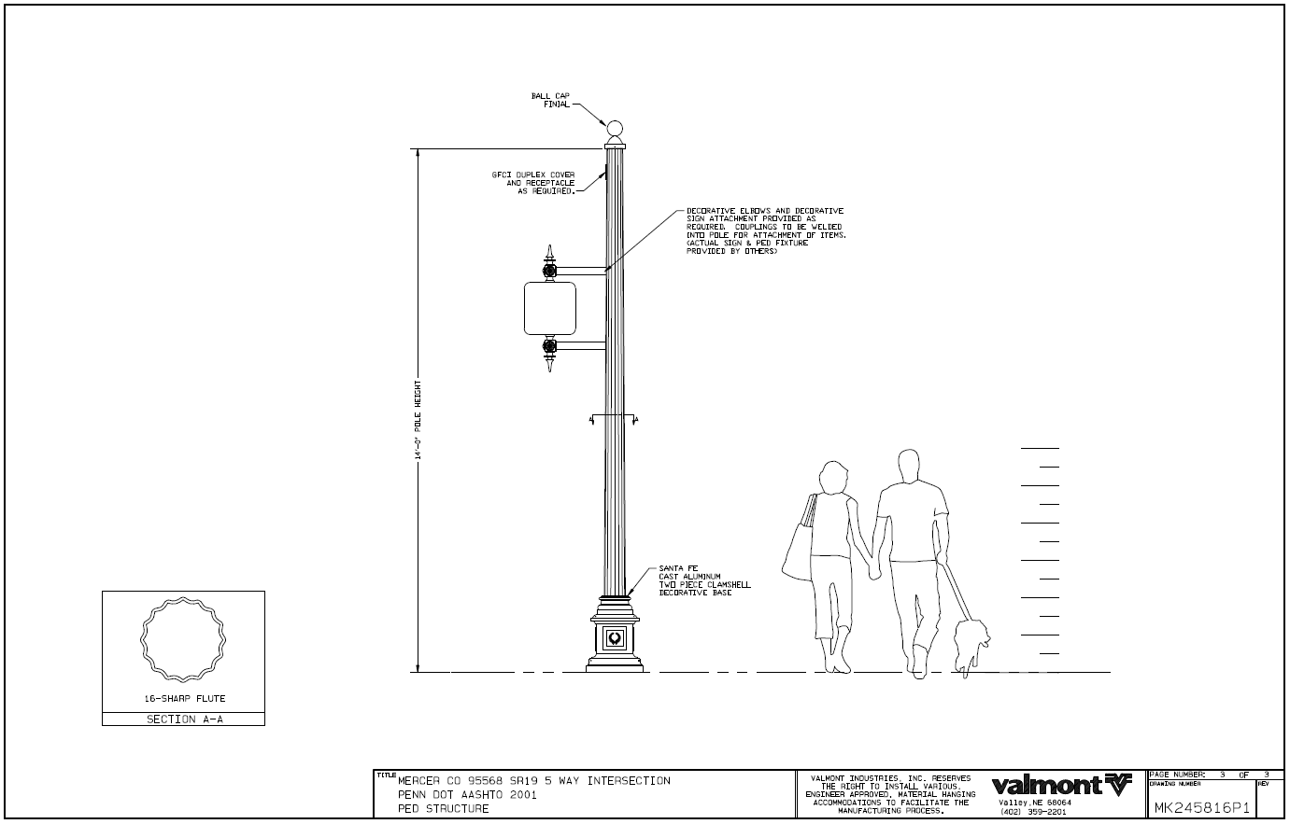
2D Marketing Illustration

Slide 12
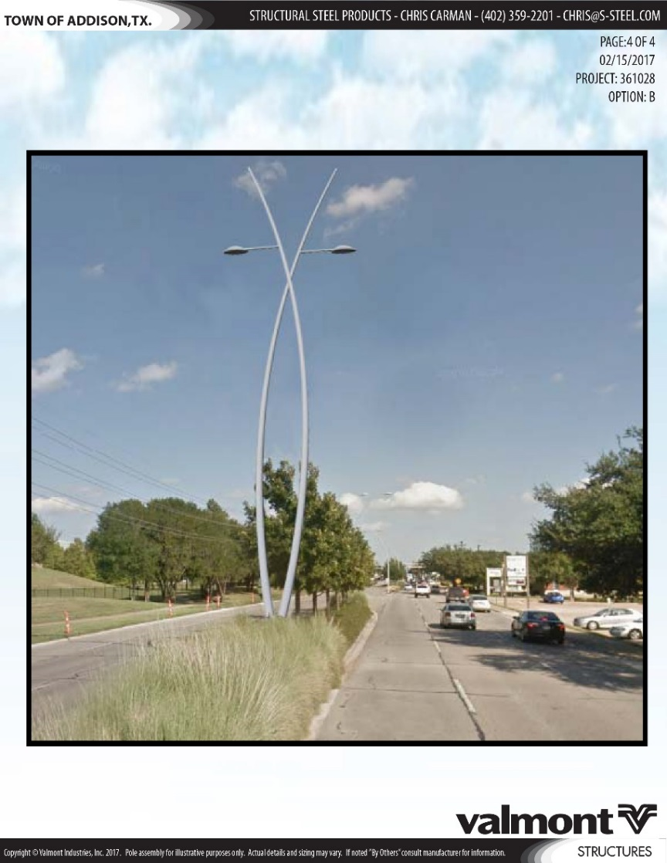
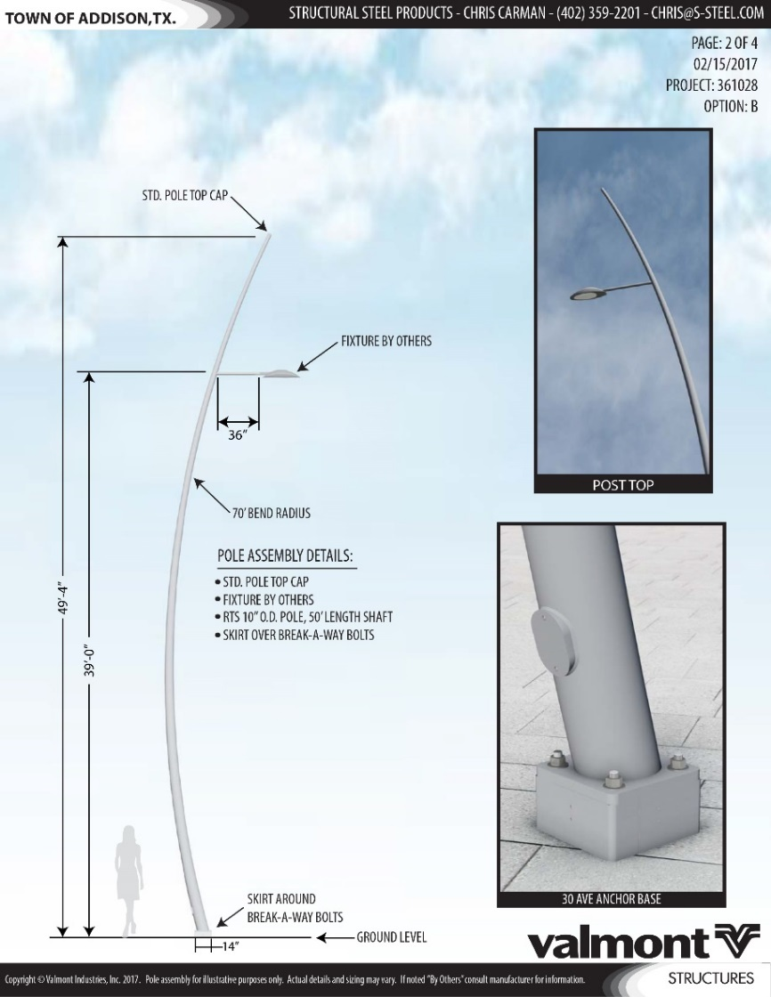
3D Marketing Illustration

Slide 13
Types of Customer Drawings and Their Purpose
    Sales Proposal
    Application: Drawing support for quotes
    Typical Lead Time: 5 working days
    A detailed drawing created during the quote stage to assist the agent and Valmont in securing the order. Sales Proposals often lack some of the necessary details that have yet to be defined. This type of drawing lacks the details necessary for Valmont to release for manufacturing.
    Full paper size is 11” x 17”.

Slide 14
Types of Customer Drawings and Their Purpose
    Submittal Drawing
    Application: Pre-release design approval
    Typical Lead Time:
    A detailed drawing created for design approval prior to the order being released for manufacturing. Drawing is sent to the project owner or approving authority for review and approval. Drawing can be returned approved without exception, approved as noted, or reject and resubmit.
    Full paper size is 11” x 17”.
    Transportation Products – 6 working days + 1 day if a PE stamp is required
    Commercial Products – 5 working days + 1 day if a PE stamp is required

Slide 15
Types of Customer Drawings and Their Purpose
    Record Drawing
    Application: Post release documentation
    Typical Lead Time: Varies by product type based on released lead time
    A detailed drawing created for record purposes after the project has been released for manufacturing. Record prints are provided as a record of the released product and do not require review and approval.
    Full paper size is 11” x 17”.

Slide 16
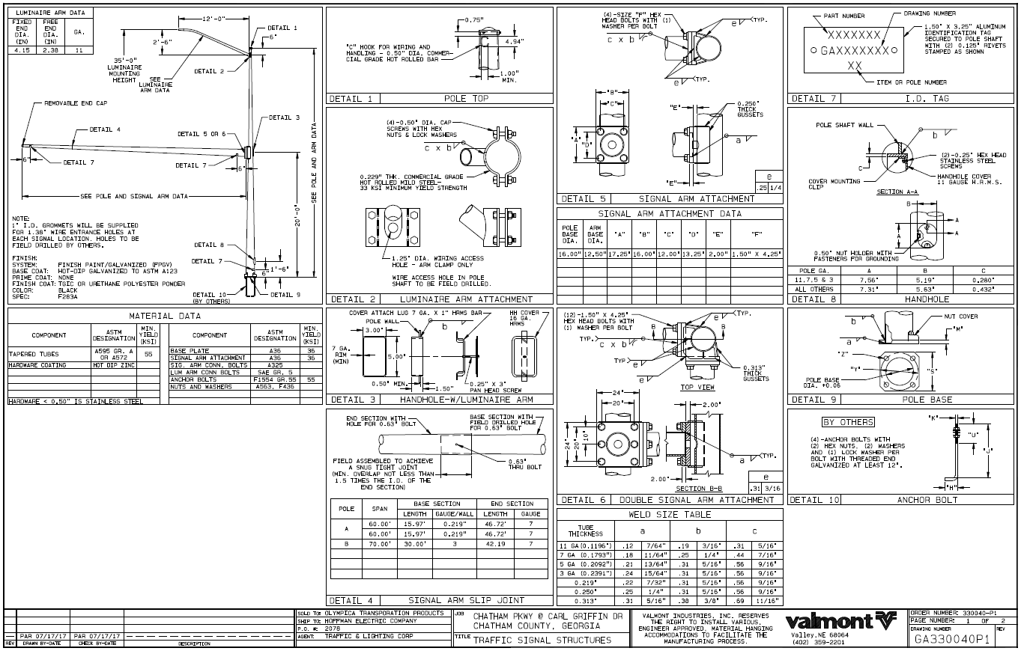
Sales Proposal, Submittal, Record

Slide 17
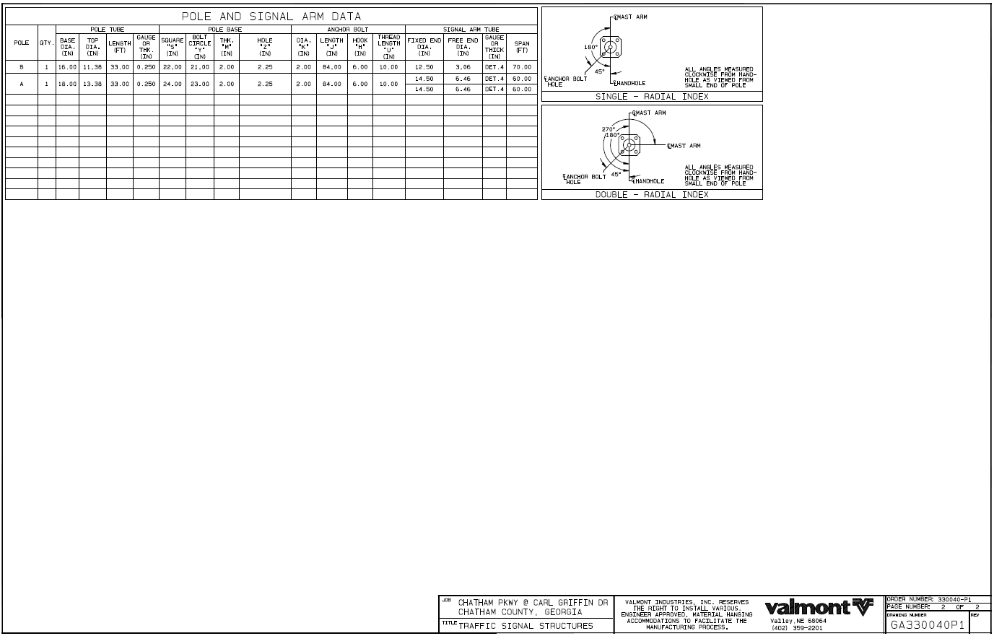
Sales Proposal, Submittal, Record

Slide 18
Types of Customer Drawings and Their Purpose
    DB Drawing
    Application: Drawing detailing a specific customer’s standards
    Typical Lead Time: Varies based on customer’s required date
    A detailed drawing reflecting a standard product design for an entity such as a Utility, County, City, or State. A DB drawing is intended to be reviewed and approved by the entity and is often specified in bid documents such as the written specifications. This type of drawing is used for multiple projects when standard product is ordered.
    Full paper size is 11” x 17”.

Slide 19
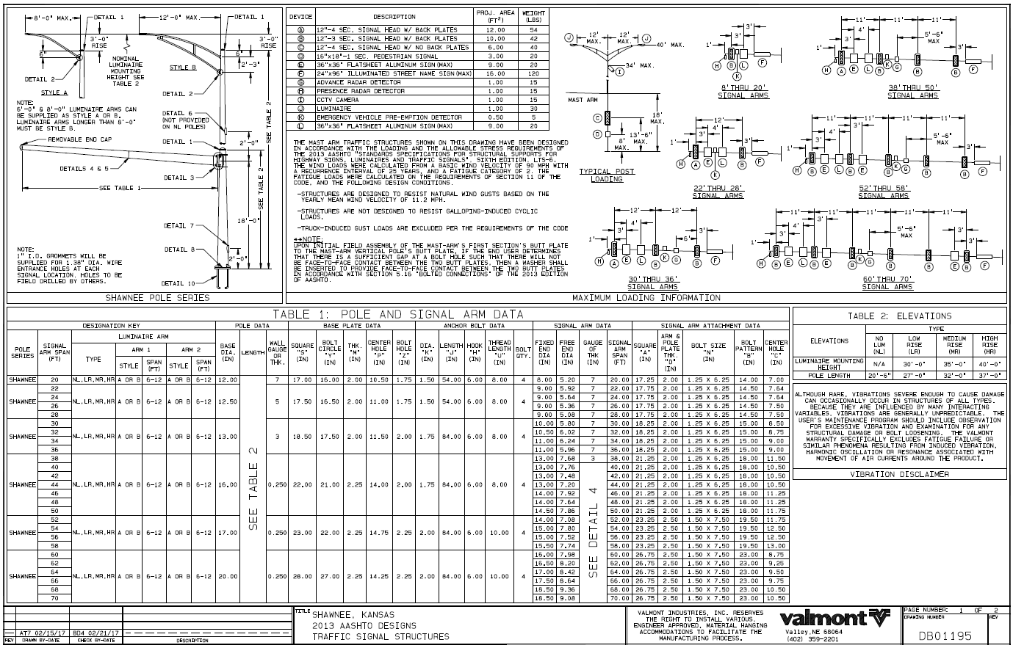
DB Drawing

Slide 20
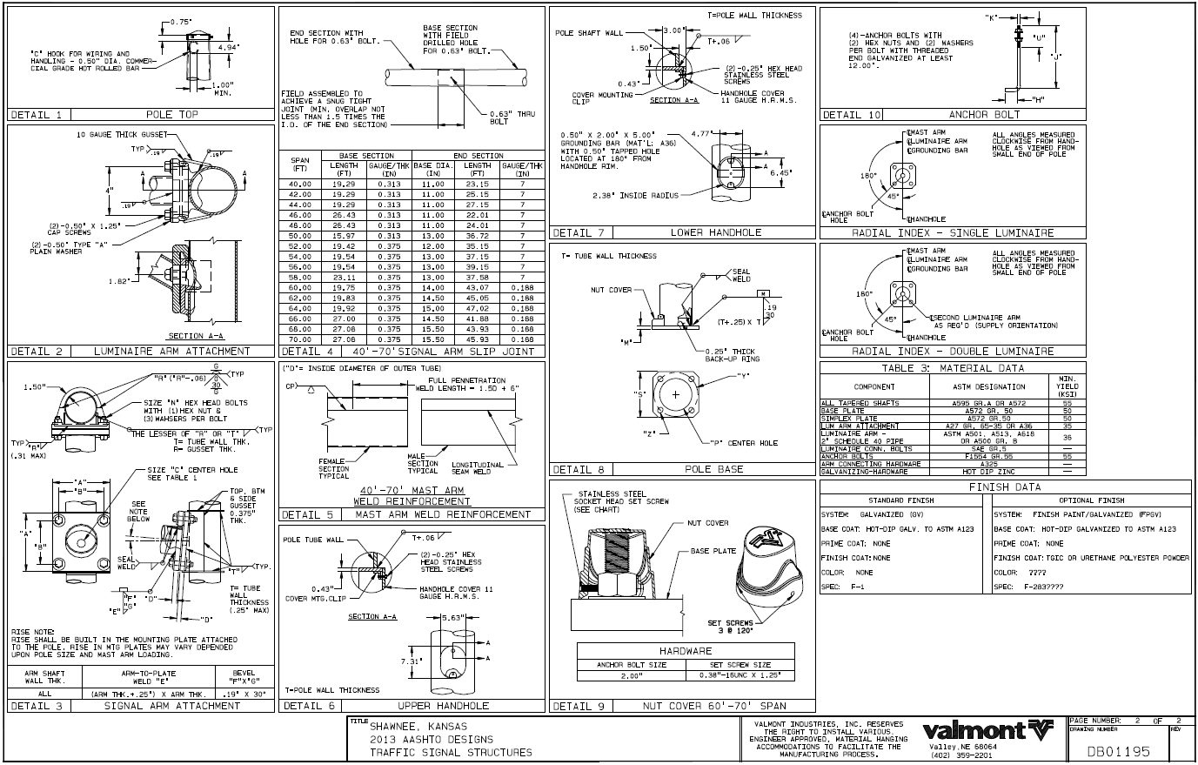
DB Drawing

Slide 21
Standard Drawing
Layout
04

Slide 22
Standard Drawing Layout
  Title Block
    The title block is located along either the top or the bottom of the drawing page.
      A full title block is located on the first page of drawing.
      A partial title block is located on each additional page.
    The title block provides pertinent information as each drawing is specific to either a project or a customer.

Slide 23
Standard Drawing Layout
    2-D Marketing Illustration drawing title block – first page – lower right corner to lower left corner
Page Number in Drawing Set
Drawing Number (MK + Valmont Project Number)
Revision Letter (if applicable)

Slide 24
Standard Drawing Layout
    2-D Marketing Illustration drawing title block – first page – lower right corner to lower left corner
Valmont Logo and Phone Number
Material Handling Disclaimer

Slide 25
Standard Drawing Layout
    2-D Marketing Illustration drawing title block – first page – lower right corner to lower left corner
Job or Project Name

Slide 26
Standard Drawing Layout
    2-D Marketing Illustration drawing title block – first page – starting in lower left corner
Revision Letter (if applicable)
Drawn By Initials and Date (original and revision)
Check By Initials and Date (original and revision)
Description of Drawing Revision (if applicable)

Slide 27
Standard Drawing Layout
    2-D Marketing Illustration drawing title block – additional pages – lower right corner to lower left corner
Page Number in Drawing Set
Drawing Number (MK + Valmont Project Number)
Revision Letter (if applicable)

Slide 28
Standard Drawing Layout
    2-D Marketing Illustration drawing title block – additional pages – lower right corner to lower left corner
Valmont Logo and Phone Number
Material Handling Disclaimer

Slide 29
Standard Drawing Layout
    2-D Marketing Illustration drawing title block – additional pages – lower right corner to lower left corner
Job or Project Name

Slide 30
Standard Drawing Layout
    2-D Marketing Illustration drawing title block – additional pages
Revision, Drawn By, and Check By information only documented on first page of drawing set.

Slide 31
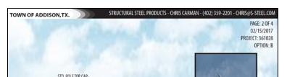
Standard Drawing Layout
    3-D Marketing Illustration drawing title block – starting at top of page
Job or Project Information

Slide 32
Standard Drawing Layout
    3-D Marketing Illustration drawing title block – starting at top of page
Agent Information

Slide 33
Standard Drawing Layout
    3-D Marketing Illustration drawing title block – starting at top of page
Page Number in Drawing Set
Date Drawing Created
Project Number
Option Information

Slide 34
Standard Drawing Layout
    Sales Proposal, Submittal, and Record drawing title block – first page – lower right corner to lower left corner
Valmont Order Number
Page Number in Drawing Set
Drawing Number (State + Valmont Order Number)
Revision Letter (if applicable)

Slide 35
Standard Drawing Layout
    Sales Proposal, Submittal, and Record drawing title block – first page – lower right corner to lower left corner
Valmont Logo and Phone Number
Material Handling Disclaimer

Slide 36
Standard Drawing Layout
    Sales Proposal, Submittal, and Record drawing title block – first page – lower right corner to lower left corner
Job or Project Name
Title or Product Type

Slide 37
Standard Drawing Layout
    Sales Proposal, Submittal, and Record drawing title block – first page – lower right corner to lower left corner
Sold To Name
Ship To Name
Purchase Order Number
Agent Name

Slide 38
Standard Drawing Layout
    Sales Proposal, Submittal, and Record drawing title block – first page – starting in lower left corner
Revision Letter (if applicable)
Drawn By Initials and Date (original and revision)
Check By Initials and Date (original and revision)
Description of Drawing Revision (if applicable)

Slide 39
Standard Drawing Layout
    Sales Proposal, Submittal, and Record drawing title block – additional pages – lower right corner to lower left corner
Valmont Order Number
Page Number in Drawing Set
Drawing Number (State + Valmont Order Number)
Revision Letter (if applicable)

Slide 40
Standard Drawing Layout
    Sales Proposal, Submittal, and Record drawing title block – additional pages – lower right corner to lower left corner
Valmont Logo and Phone Number
Material Handling Disclaimer

Slide 41
Standard Drawing Layout
    Sales Proposal, Submittal, and Record drawing title block – additional pages – lower right corner to lower left corner
Job or Project Name
Title or Product Type

Slide 42
Standard Drawing Layout
    Sales Proposal, Submittal, and Record drawing title block – additional pages
Sold To, Ship To, Purchase Order Number, Agent Name, Revision, Drawn By, and Check By information only documented on first page of drawing set.

Slide 43
Standard Drawing Layout
    DB drawing title block – first page – lower right corner to lower left corner
Page Number in Drawing Set
Drawing Number (Always starts with DB)
Revision Letter (if applicable)

Slide 44
Standard Drawing Layout
    DB drawing title block – first page – lower right corner to lower left corner
Valmont Logo and Phone Number
Material Handling Disclaimer

Slide 45
Standard Drawing Layout
    DB drawing title block – first page – lower right corner to lower left corner
Job or Project Name
Title or Product Type

Slide 46
Standard Drawing Layout
    DB drawing title block – first page – starting in lower left corner
Revision Letter (if applicable)
Drawn By Initials and Date (original and revision)
Check By Initials and Date (original and revision)
Description of Drawing Revision (if applicable)

Slide 47
Standard Drawing Layout
    DB drawing title block – additional pages – lower right corner to lower left corner
Page Number in Drawing Set
Drawing Number (Always starts with DB)
Revision Letter (if applicable)

Slide 48
Standard Drawing Layout
    DB drawing title block – additional pages – lower right corner to lower left corner
Valmont Logo and Phone Number
Material Handling Disclaimer

Slide 49
Standard Drawing Layout
    DB drawing title block – additional pages – lower right corner to lower left corner
Job or Project Name
Title or Product Type

Slide 50
Standard Drawing Layout
    DB drawing title block – additional pages
Revision, Drawn By, and Check By information only documented on first page of drawing set.

Slide 51
Standard Drawing Layout
  Details
    Drawings include a detail showing the structure elevation providing an overall view of the assembly.
    Drawings include details showing components and their requirements.
      Provided by Valmont unless otherwise noted.
    Details are specific to either the project or the customer.

Slide 52
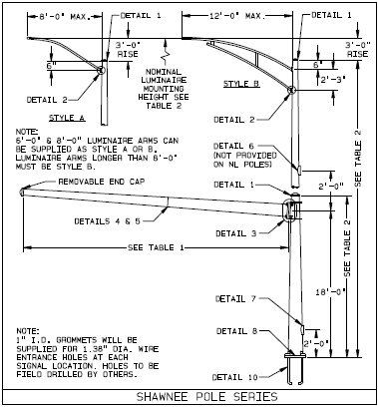
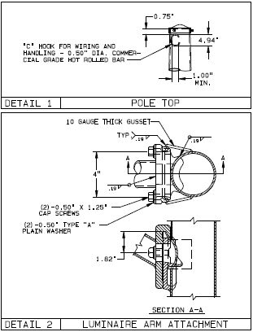
Standard Drawing Layout
  Upper left corner of drawing – structure elevation detail
    Overall structure detail
    Component locations
    Component detail numbers
    Reference dimensions
    Additional notes
  Details throughout drawing
    Material type, material sizing, location of the component, weld type and weld size
    Components provided by Valmont unless otherwise noted
  Details are not to scale

Slide 53
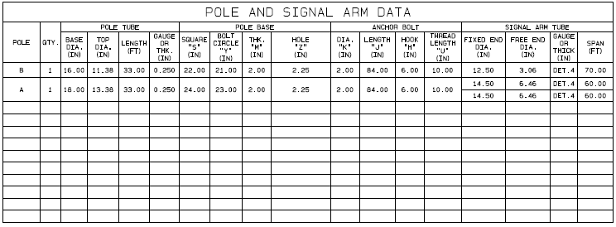
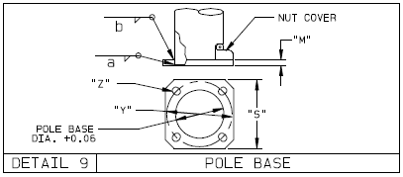
Standard Drawing Layout
  Tables
    Tables contain information regarding structures and components.
    Tables can be used in conjunction with a detail.
      Information provided within a table relates to a variable within a specific detail.

Slide 54
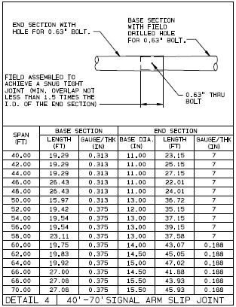
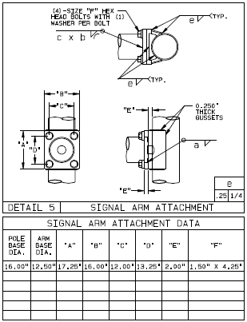
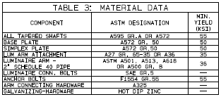
Standard Drawing Layout
  Material Data table
    Component name
    ASTM (American Society for Testing and Materials) designation information
    Min. Yield (KSI) – tensile strength of steel
  Tables contain data for details using variables

Slide 55
Standard Drawing Layout
  Notes
    Notes provide additional information outside a detail or table.
    Notes address missing or needed information prior to release for manufacturing.
      This information MUST be provided and is needed for processing.

Slide 56
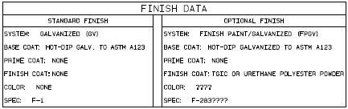
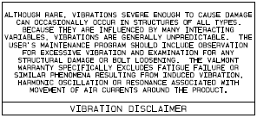
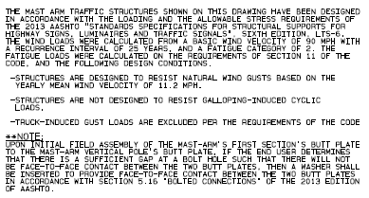
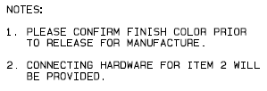
Standard Drawing Layout
  Finish Data
  Vibration Disclaimer
  Notes addressing missing or needed information
  Design criteria

Slide 57
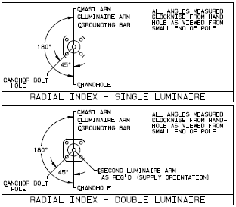
Standard Drawing Layout
  Radial Index
    Radial index depicts the orientation of components in relation to each other.
    Valmont standardly uses the handhole located at the base of the pole as the reference point – 0°.
      Some customers standardly orient off a different provision so always be sure to review the radial index.
    Radial view from the top of the pole.
There may be multiple Radial Indexes depending on the bill of material.

Slide 58


Typical Drawing Symbols
  As we never know who will be reviewing our customer drawings, we do not standardly use symbols and abbreviations that are difficult to decipher.
Typical Drawing Symbols

Slide 59
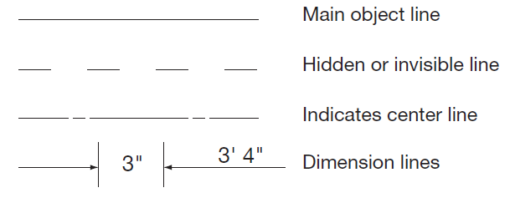
Typical Drawing Symbols
  Typical drawing symbols can be found within details to indicate such things as:
    Line types
    Break lines in shaft or pipe
    Weld types
Typical Line Types

Slide 60
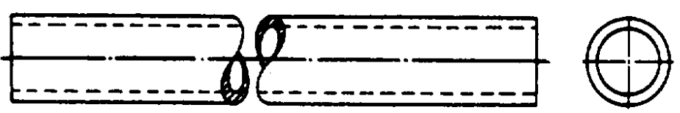
Typical Drawing Symbols
Break Line in Shaft or Pipe

Slide 61
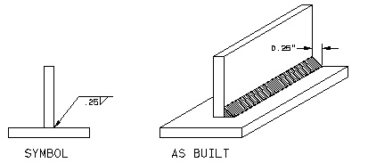
Typical Drawing Symbols
Weld Symbols
  Fillet weld
    The most commonly used weld symbol
    When symbol and dimension are on the bottom side of the leader, the weld is to be located on the near side.
    When symbol and dimension are located on the top side of the leader, the weld is to be placed on the opposite side of the material to which the arrowhead is pointing.

Slide 62
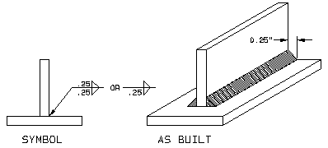
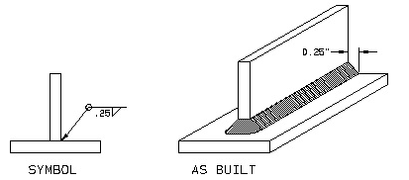
Typical Drawing Symbols
Weld Symbols
  Fillet weld
    When symbols are located on the top and bottom of the leader, there is to be a weld on both sides of the material.
    When a circle is shown on the weld symbol, the weld should go all the way around the material.

Slide 63
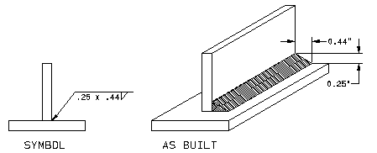
Typical Drawing Symbols
Weld Symbols
  Fillet weld
    On an unequal leg weld the height of the weld is different than the width. Both the height and width are specified on the weld symbol.

Slide 64
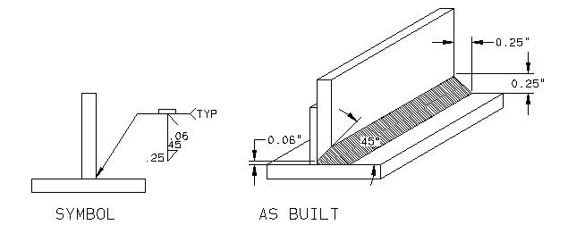
Typical Drawing Symbols
Weld Symbols
  Complete Joint Penetration (CJP) weld
    Another commonly used weld
    A root opening between the materials is to assure the weld flows all the way to the other side (full penetration).

Slide 65
Typical Drawing Symbols
Weld Symbols
  Complete Joint Penetration (CJP) weld
    The rectangle on top of symbol represents backing. When you have a root opening you also need a material to stop the weld from blowing through the opening.
    The angle specified is the angle the vertical material is ground to create the groove opening.
    The fillet weld height and width are noted.

Slide 66
Wrap-Up
  Contact information
    Tom Gregory, Drafting Manager
      tgregory@valmont.com
      1 (402) 359-2201 Extension number 3454
    Candace Hanway, Training and Development Specialist
      candace.hanway@valmont.com
      1 (402) 359-2201 Extension number 3785

Slide 67
THANK YOU!
valmontstructures.com

